Slide 1
How effective is the combination of you main product and ancillary texts?
On this Power Point Presentation I will be discussing my answer to the question above.

Slide 2
Poster 1&2 Genre/Audience
The genre of our film ‘Turkish Delight’ is somewhat of a hybrid genre. Despite this, the main underlying theme within the short film itself is comedy/black comedy.
Due to this being the main ‘genre’, this was what I intended to convey through my two posters. I needed to allude to the darkness that was to come within the film, whilst also adding hints which showed comedy.
Our film is aimed for two audiences teenage/young adults and older/’Art House’ audiences. In order to appeal to both, we had to apply conventions through the use of awards and reviews in order to indicate what audiences would be attracted to our film. In addition to this the use of font played a crucial part in conveying what audiences we were attempting to attract.

Slide 3
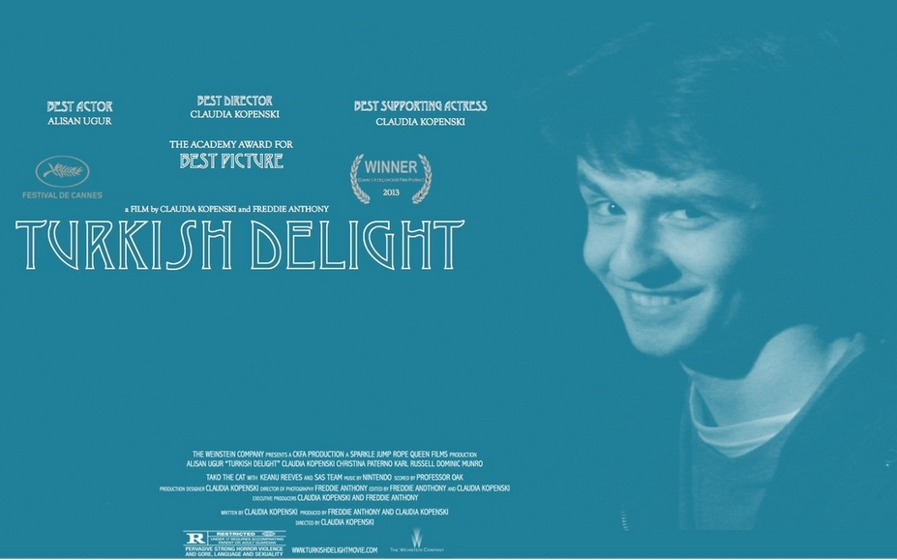
The font used for ‘Gotta Catch em all’ provides an edgier aspect to the more contemporary second poster, this indicating that this poster is aimed to attract younger audiences whereas the first poster is aimed for older/’Art House’ audiences.
In order to enable our films ‘brand’ to be established in both posters, we used the same fonts (with the exception of the font used for ‘gotta catch em all?). In addition to this, the use of the same aesthetically bold colors, teal and black & white.

Slide 4
Through indicating the ‘The Weinstein Company’ has ‘produced’ our film it immediately attracts an independent audience, also indicating that our film would be an independent release. Furthermore, through advertising Academy Award nominations it further indicates a the certain audiences this film is intended for. In addition to this, through advertising our ‘wins’ at Cannes Film Festival it adds a balance to the more ‘commercial’ Oscars, indicating that our film is aimed to appeal to both audiences.
The publications which I have included ‘reviews’ from on the posters were used to further promote my films brand and overall content/audiences. Through using both ‘Empire Magazine’ and the BFI’s ‘Sight & Sound’ two different audiences are indicated. An older/’Art House’ type and a younger, possibly more Hollywood/modern audience. Thus appealing to both audiences. However on poster two the use of reviews instead of award nominations adds a colloquial effect to the poster indicating that it is aimed for possibly a younger audience.

Slide 5
When looking to communicate the genre itself, the use of image was crucial. Our choice to use our actors face to advertise the film was based on the fact that it would immediately promote and actor/audience connection before audiences have watched the film. The two images both are of our lead actor pulling comedic yet dark faces, this balance was crucial as we needed to convey both the comedic and black comedic genres. Through using our actors face it also added somewhat of a direct and personal aspect to the ‘brand’ we we attempting to convey.

Slide 6
Film Article
As we envisioned our film being released by ‘The Weinstein Company’ we ultimately imagined a more serious audience would be watching our film. Although one of our target audiences, if not our main one is teenagers/young adults. I imagined that they would be an audience that was interested in more artistically driven, intellectual films, possibly students of film/drama/art themselves.
After analyzing two different magazine articles from the magazines ‘Sight & Sound’ and ‘Empire’ I found that although ‘Empire’ was seemingly more aimed for slightly younger audiences, ‘Sight & Sound’ was more appropriate for our films overall content and genre, furthermore I myself read ‘Sight & Sound’ therefore indicating that our target audience would read the magazine. In addition to this, ‘Empire’ seemed too commercial of a magazine to fully represent our film, therefore making ‘Sight & Sound’ an even more obvious choice to base our article layout on.

Slide 7
The choice of an image fully reflective of the film indicates the depth that a ‘Sight & Sound’ article will to go to to remain truthful to the film and not attempt to paint another genre to appeal to its readers.
The credits given to the production team indicate that the ‘stars’ are not the most important thing in terms of the film, this also indicating the more Independent and less stereotypically commercial side to film.
Image of article and further information will be added upon completion of article
The simple and plain colors indicate that audiences will be seeing the film for its content and reading the article for its content opposed to looking at the colors, pictures and fun facts about the film.
The in depth synopsis and review of the film also allude to the intellectual aspect of the films content further promoting our films ‘brand’.

